Slide 1



Amazon Product Rating and Review Analysis
Group 1:
1. Shiva Kotagiri 2. Rohith Reddy Kolanu 3. Vineet Reddy Saddi 4. Prakash Sai Alla 5. Pratham Patel

Slide 2

Motivation/Business Context
The dataset utilized in this project comprises detailed information about over 1,000 Amazon products, collected to analyze e-commerce performance metrics. Each entry in the dataset represents an individual product along with various attributes that provide insights into pricing, customer feedback, and product categorization. Key data fields include:
Product Information: Fields like product_id, product_name, and category uniquely identify each product and categorize it within the broader Amazon inventory.
Pricing Details: The dataset contains both actual_price and discounted_price fields, alongside discount_percentage, allowing for an analysis of pricing strategies and discount impacts across products.
Customer Feedback: Product ratings and reviews are captured in fields such as rating, rating_count, review_title, and review_content. These provide qualitative and quantitative measures of customer satisfaction, offering insights into user perceptions and product popularity.
User Information: Attributes like user_id and user_name help identify unique reviewers, enabling analysis of review frequency and customer engagement.
Product Links and Images: The img_link and product_link fields contain URLs for product images and Amazon listings, useful for visual identification and further exploration.
The data is well-structured, with most fields containing non-null values, making it suitable for comprehensive analysis. The dataset’s diverse range of attributes supports multiple levels of insights, from product-level performance and pricing analysis to customer sentiment and review patterns. This depth of information enables a thorough exploration of Amazon’s e-commerce metrics and lays a strong foundation for building an insightful dashboard.

Slide 3
Data Description
Data Source: https://www.kaggle.com/datasets/karkavelrajaj/amazon-sales-dataset/data
Format: .csv
Key Variables: The dataset contains 16 columns. The list of the Data Type of our variables are numeric, character, varchar. For all the numeric values the mean value is 3894.46, maximum value is 98250, and the minimum value is 0.
Number of Rows/Records: The total number of rows or records is 1465.

Slide 4
Data Preparation
Analyzed the dataset containing sales, ratings, and review data of Amazon products.
1
Verified the structure and contents to ensure compatibility with analytical tools.
2
Handled missing values by removing or imputing them where necessary.
3
Removed duplicates to maintain data integrity and eliminate redundancy.
4
Standardized formats for columns like dates, text, and categories.
5
Normalized numerical features to a consistent scale for better analysis and visualization.
6
Ensured the prepared data is free of errors and inconsistencies.
7
Validated the dataset against the original source for accuracy.
8

Slide 5
Research Questions
1. Which products have the highest and lowest ratings within each category? 2. What is the distribution of discount percentages across all products? 3. What are the top 10 lowest-rated products, and how do their ratings compare? 4. Who are the top 10 users by the number of reviews, and how many reviews have they submitted? 5. What are the top 10 most expensive products, and how do their prices compare? 6. Is there a relationship between the discount percentage and the number of reviews or rating? 7. Which product categories receive the highest number of reviews, and how do they compare across categories? 8. How are product ratings distributed across a scale of 1 to 5, and which rating is the most common?

Slide 6
Methodologies
The analysis focuses on Amazon product ratings, reviews, pricing, and discounts. It aims to uncover patterns in customer feedback, pricing trends, and category performance.
Bar Chart: Highest and Lowest Rated Products Highlights the products with the maximum and minimum ratings.
Scatter Plot: Relationship Between Price and Ratings Visualizes how product prices correlate with average customer ratings.
Treemap: Review Activity Across Categories Shows the distribution of reviews across various product categories.
Bar Chart: Distribution of Ratings (1-5 Scale) Illustrates the count of ratings across rating bins.

Slide 7
Methodologies
Bar Chart: Top 10 Most Expensive Products
Highlights the most premium-priced products.
Bar Chart: Top 10 Products with Highest Discounts
Displays products with the largest discounts offered.
Bar Chart: Top 10 Products with Lowest Ratings
Focuses on the least-rated products and potential improvement areas.
Line Chart: Top 10 Users by Number of Reviews
Tracks the most active users based on the number of reviews posted.

Slide 8

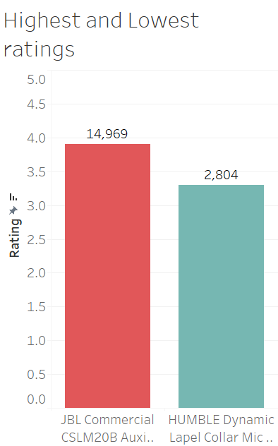
Highest and Lowest Ratings
Findings:
The JBL Commercial CSLM20B Aux Microphone stands out as the product with the highest rating count of 14,969, reflecting its popularity and strong customer engagement. In contrast, the HUMBLE Dynamic Lapel Collar Microphone has the lowest rating count of 2,804, indicating relatively lower customer satisfaction or engagement. This significant disparity in ratings highlights the variation in product popularity and feedback, offering insights into customer preferences and areas for improvement in less popular products.

Slide 9
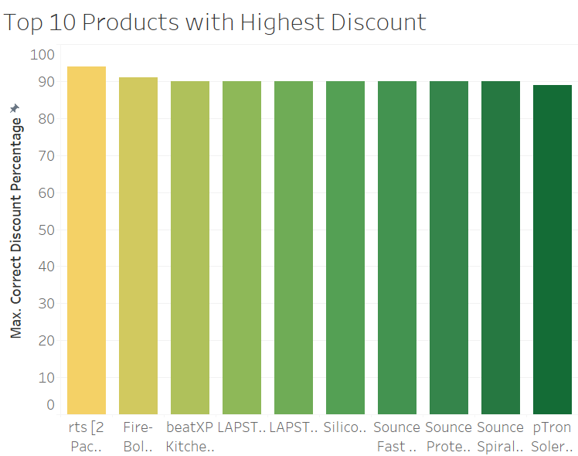
Top 10 Products with Highest Discount
Findings:
The analysis of the top 10 products with the highest discounts reveals that all these items have discount percentages exceeding 90%, making them highly appealing to cost-conscious customers. The product with the highest discount is listed as rts [2 Pac...], followed closely by products such as Fire-Bol... and beatXP LAPST..., indicating a strong focus on offering substantial price reductions in categories like gadgets and accessories. This insight highlights a significant promotional strategy to attract buyers, potentially driving increased sales and clearing inventory.

Slide 10
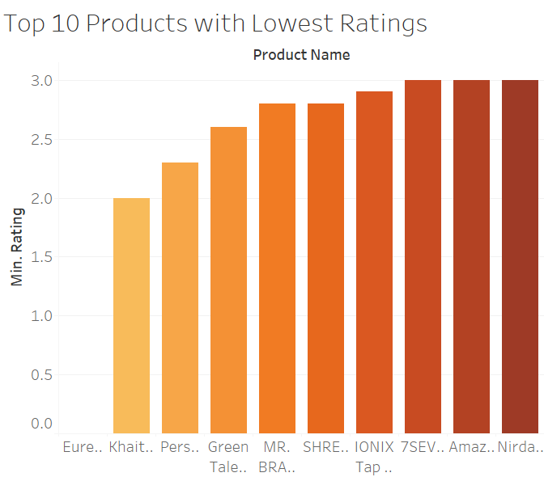
Top 10 Products with Lowest Ratings
Findings:
The analysis of the top 10 products with the lowest ratings reveals that all these items have ratings below 3.0, indicating significant dissatisfaction among customers. The lowest-rated product is Eure..., followed by Khait... and Pers..., with ratings slightly improving but still within the low range. These products might suffer from quality issues, unmet expectations, or inadequate descriptions. The consistent low ratings highlight areas where customer feedback can guide improvements, such as enhancing product quality or adjusting marketing strategies to align with consumer expectations.

Slide 11
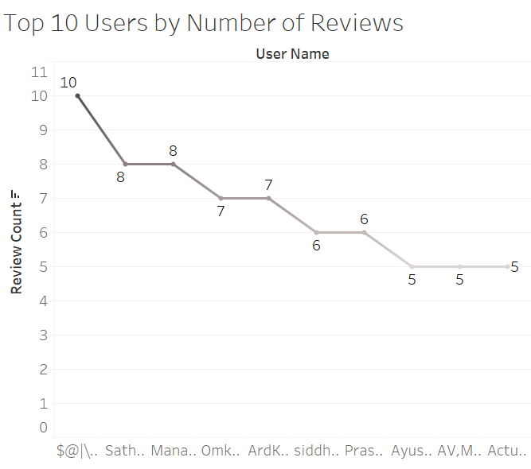
Top 10 Users by Number of Reviews
Findings:
The analysis of the top 10 users by the number of reviews reveals that the most active user, $@|.., has submitted 10 reviews, followed by users like Sath... and Mana... with 8 reviews each. The activity gradually decreases, with the least active users in this group contributing 5 reviews each. This indicates a small group of highly engaged users who actively provide feedback on products, which could be leveraged to gather more detailed insights or as a target for promotional campaigns to encourage further engagement.

Slide 12
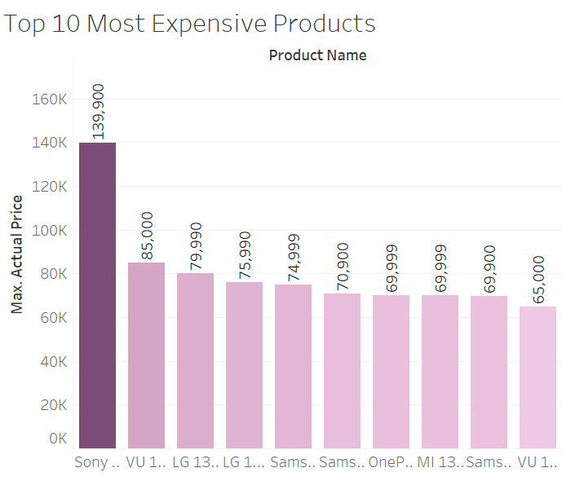
Top 10 Most Expensive Products
Findings:
The analysis of the top 10 most expensive products reveals that the Sony... product ranks as the costliest item with a price of ₹139,900, significantly higher than other products in this category. Following this, items like VU 1... and LG 13... are priced at ₹85,000 and ₹79,990, respectively. The price range for these top products spans between ₹65,000 and ₹139,900, predominantly featuring premium electronics and home appliances. This highlights the presence of high-end offerings on the platform catering to affluent customers or niche markets.

Slide 13
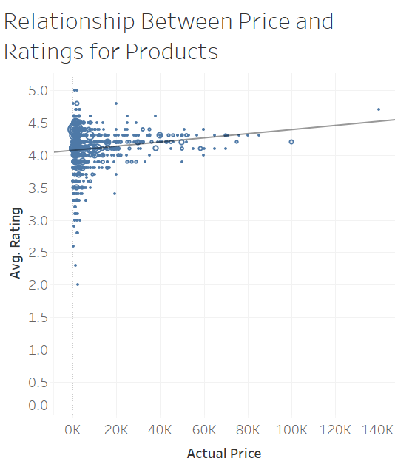
Relationship Between Price and Ratings for Products
Findings:
The scatter plot analyzing the relationship between product price and average ratings indicates a slight positive correlation, suggesting that higher-priced products generally tend to receive better ratings. Most products are clustered in the lower price range (below ₹20,000) with an average rating around 4.0, highlighting strong customer satisfaction in affordable categories. However, as prices increase, the spread in ratings becomes narrower, reflecting consistent quality or customer expectations in premium product segments. This insight can help identify pricing strategies and quality standards for various product categories.

Slide 14
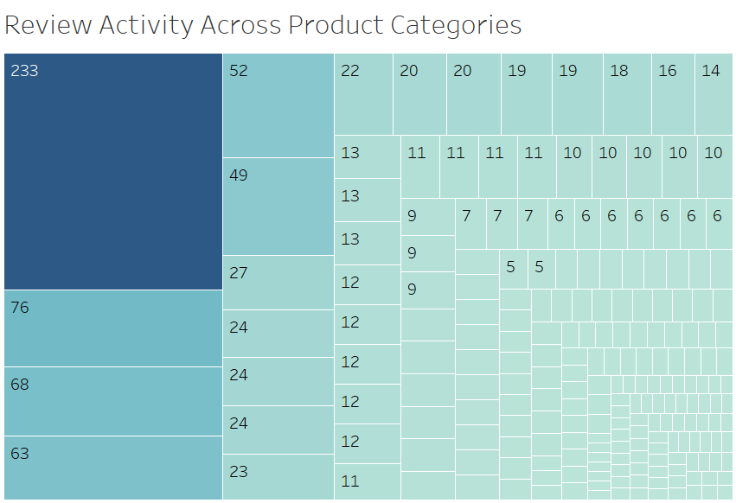
Review Activity Across Product Categories
Findings:
The Treemap showcasing review activity across product categories highlights significant variation in customer engagement. One category stands out with 233 reviews, dominating the others by a large margin. The next most active categories have 76, 68, and 63 reviews, showing a steep decline in review counts. Smaller categories with fewer reviews, ranging from 52 to 5, suggest limited customer interactions. This uneven distribution indicates that certain product categories garner more attention and customer feedback, which can guide marketing and inventory strategies to focus on high-engagement categories while improving visibility for others.

Slide 15
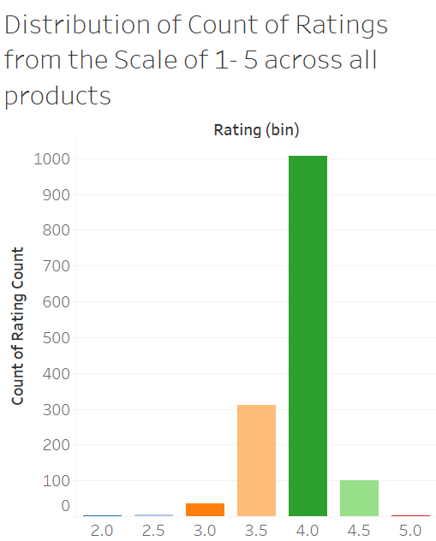
Distribution of Count of Ratings in a scale of 1 – 5 across all products
Findings:
The distribution of ratings across a scale of 1 to 5 reveals that majority of products received ratings in the 4.0-4.5 range, with over 1,000 reviews, indicating high customer satisfaction. Ratings in the 3.5-4.0 range form the second largest group, showing moderate satisfaction with fewer products rated below 3.0. Minimal reviews are observed for products rated 2.0 or below, suggesting rare occurrences of extremely negative feedback. This trend demonstrates a general preference for well-rated products on the platform, reflecting positive customer experiences for majority of offerings.

Slide 16
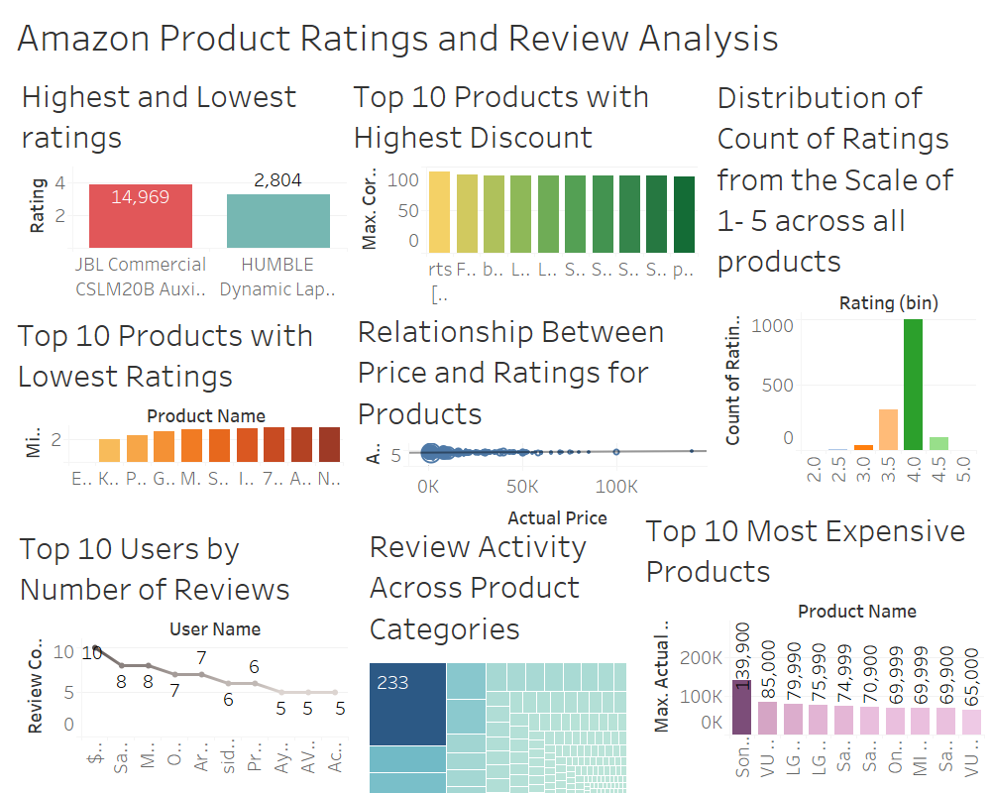
Dashboard

Slide 17
Conclusion
The analysis of Amazon product ratings, reviews, and pricing reveals significant patterns and insights. Products like the JBL Commercial CSLM20B Aux Microphone dominate in ratings, indicating their popularity, while products with the lowest ratings highlight areas for improvement. Discounts play a crucial role in customer attraction, as seen with products offering over 90% discounts, while the top 10 most expensive items reflect a focus on premium customers. Review activity varies widely across categories, with some garnering substantial feedback and others lagging. The positive correlation between price and ratings suggests that higher-priced products generally align with customer expectations. Overall, the data indicates that customer satisfaction is high, as most ratings are clustered in the 4.0-4.5 range.

Slide 18
Lessons Learned
Handling missing values, duplicates, and formatting issues is critical to ensure accurate and meaningful visualizations.
Choosing the right chart type is crucial for effectively communicating insights (e.g., scatter plots for relationships, Treemaps for distributions).
Identifying correlations (e.g., price vs. ratings) and outliers (e.g., products with the lowest ratings) helps uncover actionable trends.
Maintaining consistent chart styles, colors, and formatting across visualizations improves overall readability and professionalism.
Recognizing limitations in the dataset (e.g., missing context for ratings or biases in reviews) helps set realistic expectations for insights.

